Slide 1



MANIPAL UNIVERSITY JAIPUR ACM STUDENT CHAPTER PRESENTS

Slide 2

MUJHacks 2.0
INTRODUCTION
MUJ Hacks is Jaipur’s largest 12-hour student Hackathon, organized by Manipal University Jaipur ACM Student Chapter We believe hackers have the power to change the world – and find solutions to the biggest challenges in our time. But to make this happen, we need to stand together. Our mission is to organize a series of hackathons to empower the hacker community of Rajasthan. So come one, come all to experience hacking at it’s finest. Register now to be a part of MUJHacks 2.0, and be there to hack your way to top.

Slide 3

MUJHacks 2.0
RULES
Teams of up to 4 members allowed
Individual participants are requested to take part in the team building workshop on 12th January 2018 at Manipal University Jaipur
Dress well, no shorts will be allowed.
You are allowed to bring your snacks along.
Don’t forget to bring your college and hostel id cards
Bring your charged laptops along with the charger, and bring the extension cables and don't forget to bring Headphones :p
Teams can be disqualified from the competition at the organizers' discretion.
Use of any narcotic drug, breaking the Code of Conduct, or other unsporting behavior will lead to disqualification.

Slide 4

PROBLEM STATEMENTS

Slide 5

DISEASE PREVENTION AND CURE
A healthy population plays a key role in helping a developing country like India to grow. Government policies like the national health policy of 2017 have been implied to improve the health conditions but these are still not fulfilling their purpose completely. Malnutrition, respiratory diseases, infections caused due to a major part of the population living in areas with poor sanitation facilities, female health issues and mental disorders are few of the problems that still affect the people of the country majorly. Free healthcare is available but still limited. There is not enough healthcare infrastructure to support the growing population of the country.

Slide 6

AGRICULTURE IN INDIA
Based on the standard of the “one-dollar-a-day threshold”, there are 1.2 billion poor people in developing countries. And among these peoples, there are 780 million of them facing chronic hunger. Agriculture is an important source of livelihood. The rising agricultural production and productivity tends to improve social welfare, particularly in rural areas. India being one of the leading countries in terms of agriculture, faces several problems with it as well, as comes things with its consequences. The small and fragmented land holdings, the soil erosion caused due to the variant temperatures, lack of mechanisation, inadequate storage facilities can be some of the many. The latest technological advancements like seed implanting also has its negative side. Agriculture almost always plays a essential role in the nation’s economy as it connects and interacts with all the industries of that country. This is a major issue related to the whole society and efficient action must be taken on it.

Slide 7

POLLUTION CONTROL
Pollution is a growing problem that is faced in India due to the increase in population which in turn leads to increase in use of vehicles, contamination of water and soil, etc. The causes of pollution are not just limited to fossil fuels and carbons emissions. There are many other types of pollution including chemical pollution into bodies of water and soil through improper disposal practices and agricultural activities, and noise and light pollution created by cities and urbanization as a result of population growth. Pollution control has almost become an integral part of the process of industrialization. Appropriate laws have been passed that restrict and regulate the growth of pollution intensive industries, especially in metropolitan cities. It has been made obligatory for industrial units to adopt measures to control pollution. But it is still a big problem faced by the country and needs to be dealt with as soon as possible. Design your own hack that can contribute to pollution control.

Slide 8

IMPROVING EDUCATION SYSTEM
Education is essential but good education in India is very limited. Most of the time, the scarce resource of a good school education is only available to a few elites of the society. India's GER(Gross Enrollment Rate) is around 6% below the current world average and over 50% below first world countries like USA and Australia. Lack of Hands-on experience and uninspired educators are one of the main reasons. It often promotes rat race which leads to hindrance in personality development and lack of understanding. There seems to be a great increase of low quality institutions popping up, which lack proper infrastructure and faculty. Sometimes the skills required for the job by the graduates are simply not present as the education is irrelevant to the job market.

Slide 9
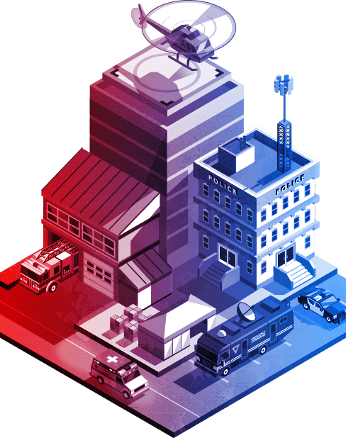
PUBLIC SAFETY AND SECURITY
Safety and security is a foundational expectation for any community around the world. The challenge and the opportunity to deliver on this base need have never been more acute. The consumerization of technology and the rapid advance of sophisticated communication tools have changed the dynamic for agencies charged with maintaining a stable community. The most advanced communications in our history are now found in the hands of the individual. Government agencies struggle under the weight of an aging, inflexible infrastructure that must lead and interoperate. Infrastructure vital to government operations has come under increased scrutiny from the domino effect with any lapse in protection. Criminal endeavors don’t adhere to predefined notions of jurisdictions. Information sharing and collaboration cannot be considered an aspiration, but a baseline.

Slide 10
MUJ HACKS 2.0
Timeline
Hackathon - 9AM - 9PM
Hackathon Details:
0900 Hrs - Hacking starts
1100 Hrs - Initial Idea Evaluation
1200 Hrs - Swag Distribution
1300 Hrs - Lunch Break
1600 Hrs - Idea Pitching / Presentation
1930 Hrs - Final submissions
2030 Hrs - Winner Declaration

Slide 11







OUR PROUD SPONSORS

Slide 12


Any questions? Contact-
Shrey Srivastava
Anmol Garg
9760962302
9557122807

